Slide 1
Online
Multilevel Memories
  Multilevel memory management mechanism
  Locality of reference and working sets
  Multilevel memory management policies
Scheduling
  Scheduling Metrics
  Scheduling Policies
Suggested reading
  6.2， 6.3

Slide 2
Missing-Page Exception Handler
Check PC
Find the address
Call SEND to multilevel memory manager
  With the request containing the missing page number
  SEND invokes ADVANCE which wakes up a thread of the multilevel memory manager
Invoke AWAIT on behalf of the application program’s thread
  AWAIT yields the processor

Slide 3
Multilevel Memory Manger
Look up the page in its page map
  Determine the address of the disk block
Locate an unused block in RAM
Issue a GET for the disk block
Write the result into the unused RAM block
Write the block number in the virtual memory manager’s page map
Change the resident bit to true
Make the thread that experienced the missing-page exception runnable
  by calling ADVANCE

Slide 4
Page-Removal
If NO free pages
  Select
    victim
  Remove it to make space
page-removal policy
  In practice, it exploits a property of locality
If the victim was modified
  PUT the page back to the disk
  Set a flag -------victim is no longer resident

Slide 5
Implicit I/Os
Implicit I/Os
  I/O operations performed by the multilevel memory manager
Using concurrency
to mitigate the I/O bottleneck
  VM manager invoke “GET”, and sleep
  assigns the processor ----→ some other thread
  When the GET completes, it notifies the thread
Notes:
Using concurrency to mitigate the I/O bottleneck
A thread of the multilevel memory manage begins to GET, and waiting the result
The multilevel memory manage assigns the processor to some other thread
When the GET completes, it notifies the thread

Slide 6
How to Organize the multilevel Memory Manager
The multilevel memory manager is a separate module
  Several multilevel memory managers can co-exist
  one use disk as big memory; another provides memory-mapped files
  separate mechanism from policy
Running in which modes?
Keep swaper’s pages wired down (lock in memory)
Notes:
What happens if there is missing page exception in the multilevel memory manage itself?
Keep some pages wired down

Slide 7
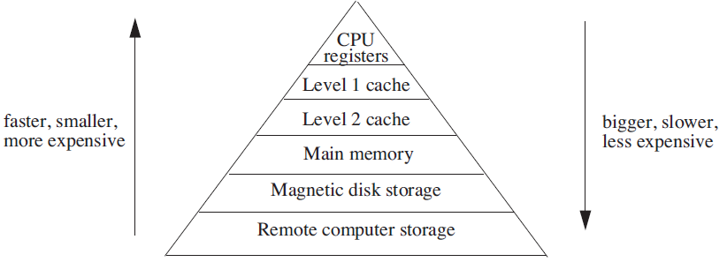
Analyzing Multilevel Memory Systems
Only consider the adjacent pair of levels
  So
  The first one is primary device
  The second is secondary device

Slide 8
Locality of reference and working sets
All information items stored in the memory must not have equal frequency of use

Slide 9
Locality of reference and working sets
If accesses to every cell of the primary and secondary devices were of equal frequency,
The primary device is L2 cache with 1 nanosecond latency and
the secondary device is main memory with 10 nanoseconds latency
0.99 + 0.10 = 1.09 nanoseconds

Slide 10
Locality of Reference and Working Sets
memory references
in
{ a small set of addresses }
for significant periods of time
the set shifts
as app progresses,
locality of reference
  Temporal locality and spatial locality

Slide 11
Multilevel Memory Management Policies
Demand algorithms
  the new page moves in
  Old one move out
  FIFO, LRU
Prepaging

Slide 12
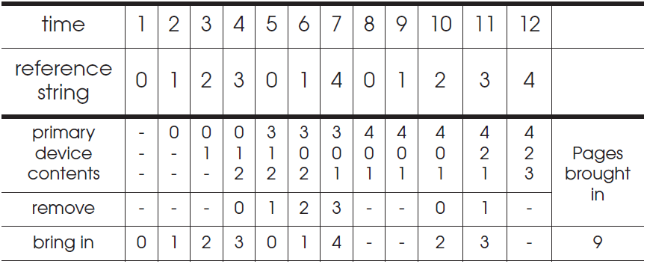
Multilevel Memory Management Policies
First-in, first-out (FIFO) page-removal policy
  The page selected for removal is the one that has been in the primary device the longest

Slide 13
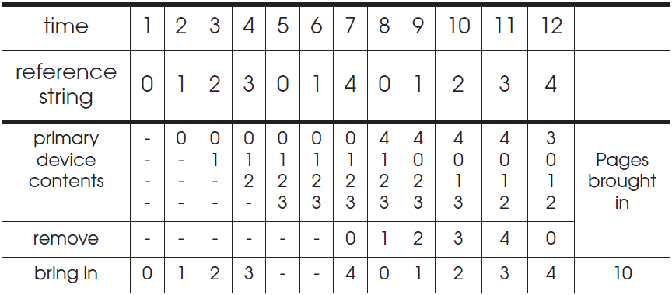
Multilevel Memory Management Policies
Belady’s anomaly
  increase of exception numbers with a larger primary device capacity

Slide 14
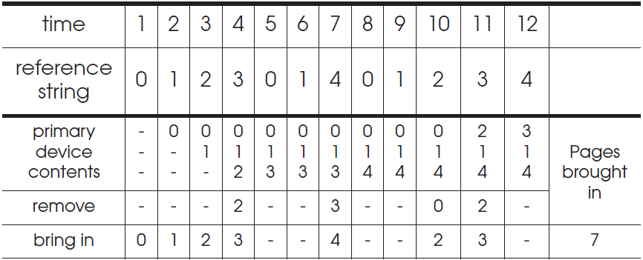
Multilevel Memory Management Policies
Optimal (OPT) page-removal policy
  Always choose for removal the page that will not be needed for the longest time

Slide 15
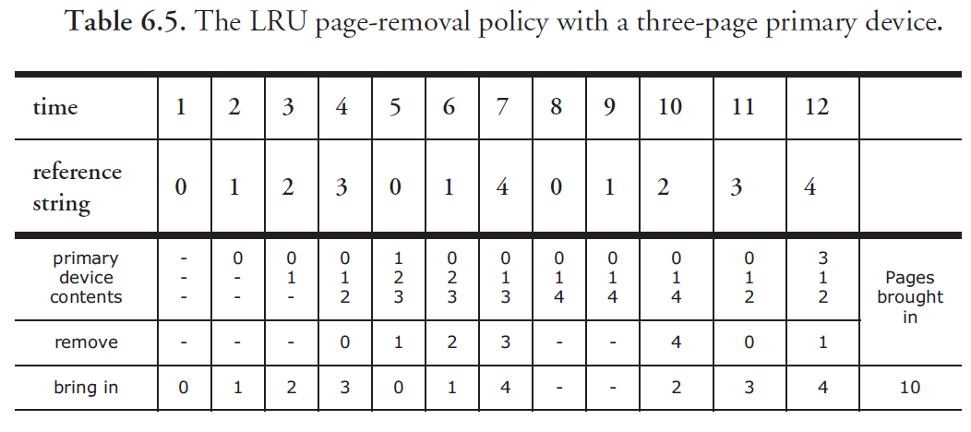

LRU

Slide 16
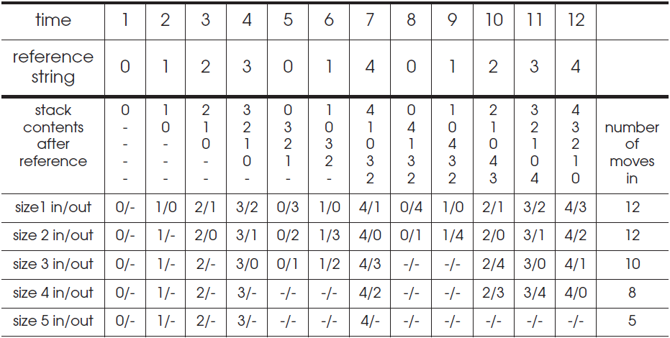
Least-recently-used (LRU) page-removal policy
The page in the primary device that has not been used for the longest time

Slide 17
MRU
4 page， 5 reference， LRU
MRU

Slide 18
Stack Algorithms
Ways of deciding the following two things:
  How large the primary memory device should be
  Which page removal policy to use
Collecting traces of the reference strings of typical programs that are to be run
Simulate the multilevel memory manager with
  different configurations
    Size of primary device
    Page removal policy
  and the traces

Slide 19
Stack Algorithms
Subset property
  For the optimal policy, at all times
  the pages it keeps in the 3-page memory
  is a subset of that it keeps in the 4-page memory
No Belady’s anomaly if subset property holds
  At all times and
  For every possible capacity of primary device
It creates a total ordering for pages at a given time

Slide 20
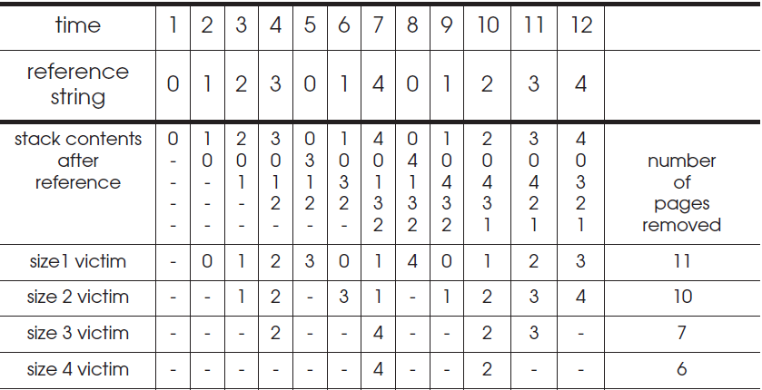
Stack Algorithms OPT
It can perform a simulation for
  all possible primary memory size with a single pass
  through a given reference string

Slide 21
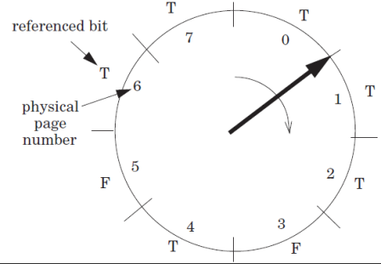
Efficiency of Page-Removal Policies
Clock page-removal algorithm
  Base on a hardware setting bit
    Reference bit
    Move clockwise
    If T, set F
    Choose as the
    victim otherwise
Random removal policy
  For TLB
Directed mapping

Slide 22

Clock page-removal algorithm

Slide 23
Prepaging
Demand paging
  pages are moved to the primary device only after the application attempts to use them
Prepaging
  the multilevel memory manager brings pages in before the application demands them
Using speculative
Combined with swapping
  For multiple-application system
  Moves all the pages of an application for a long wait when there is no enough space in the primary device

Slide 24
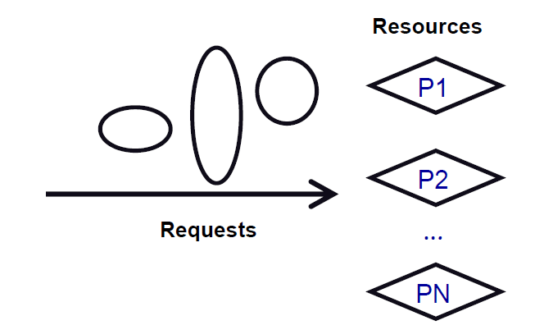
Scheduling
Scheduling policy
  Algorithm that assigns requests to resources

Slide 25
Resource vs. Entity
Processor time – Threads
Physical memory – Address spaces
Printers – Printer jobs
Disks – Disk requests
Networks – Packets
Memory bus – Memory requests

Slide 26
Challenges for Scheduling
Easy – if # requests ≤ resources
Lack of information
  Might not have good enough information
    Packet scheduling and streaming media
Lack of mechanism to enforce policies
  Give high priority to CPU scheduler
  but if you can’t get to the disk or network …
Getting mechanism right
  Many schedulers break rather than gracefully degrade under load

Slide 27
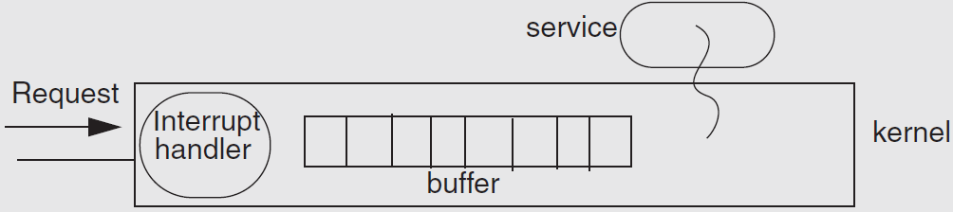
Receive Livelock
Web news server overloaded

Slide 28
The Ideal Scheduler
Minimize latency: How long a service takes?
  Example: Move mouse, cursor moves
Maximize throughput: Maximize jobs / time.
  Example: Web server pages/second
Low overheads
  Scheduler doesn’t use any resources
Fairness: everyone gets to make progress
  No one starves
Scales linearly up to capacity
  Graceful handling of overload
Unfortunately, ideal is impossible to build
  Tradeoffs

Slide 29

Alternating Sequence of CPU And I/O Bursts

Slide 30
Measuring the Request’s Response
Turn-around time
  The length of time from when a request arrives at a service until it completes
Response time
  The length of time from when a request arrives at a service until it starts producing output
Waiting time
  The length of time from when a request arrives at a service until the service starts processing the request

Slide 31
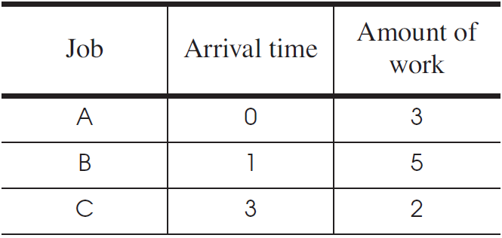
First Come First Server (FCFS)
Fairness paramount
Good for printer Scheduler

Slide 32
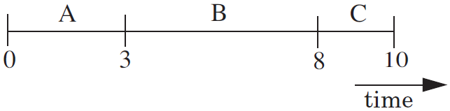
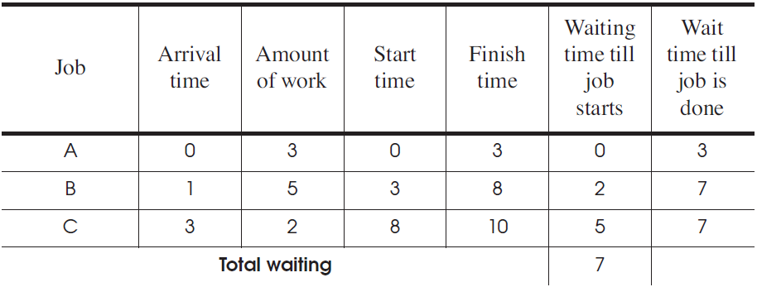
First Come First Serve (FCFS)

Slide 33
First Come First Server (FCFS)
For one processor
  One thread that periodically waits for I/O but mostly computes
  Several threads that perform mostly I/O operations
For the scheduler
  It runs the I/O-bound threads first
  Then runs the computation intensive thread
    All quickly finished computations and waiting for I/O

Slide 34
Convoy Effect
When I/O devices are idle
  The I/O-bound threads will quickly finish their computations and go start to I/O operations
  The processor-bound thread will run for a long time
  I/O-bound operations will finish their I/O operation and queuing up for computation
    All the I/O devices will become idle!
When processor is idle
  When processor-bound thread finishes its computation and starts to I/O operation
  The I/O-bound threads will quickly finish their computations and go start to I/O operations
    Processor will become idle

Slide 35
Shortest-Job-First
Whenever the time comes to dispatch a job
  it chooses the job that has the shortest expected run time
Require a prediction of the running time of a job before running
  It is difficult, in the general
  There are special cases that can work in practice

Slide 36
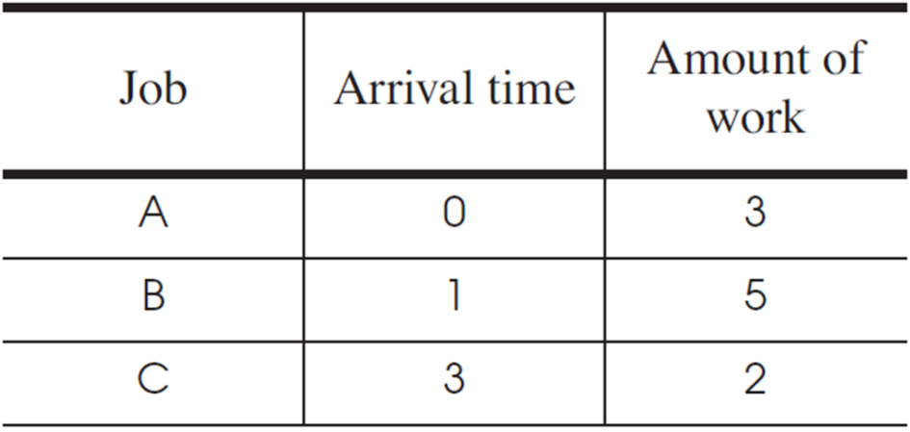
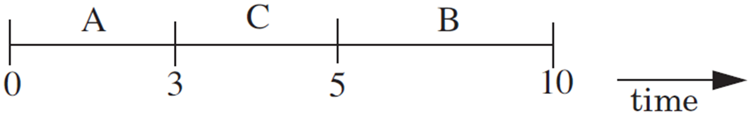
Shortest-Job-First

Slide 37
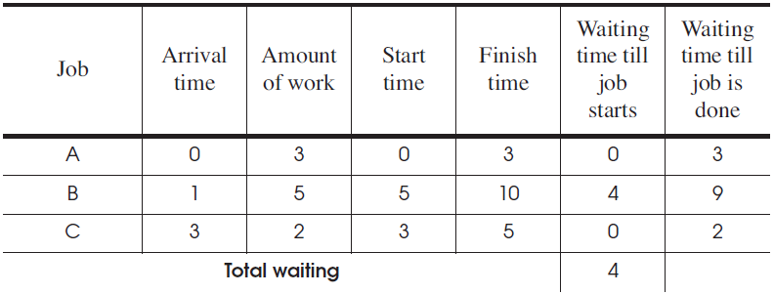
Shortest-Job-First
Starvation
  Several short jobs that together present a load large enough to use up the available processors
  may prevent a long job from ever being run

Slide 38
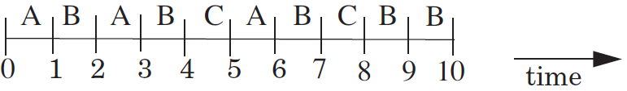
Round-Robin
Select the first job from this queue
  as in the first-come first-serve policy
Stop the job after some period of time
Select a new job

Slide 39
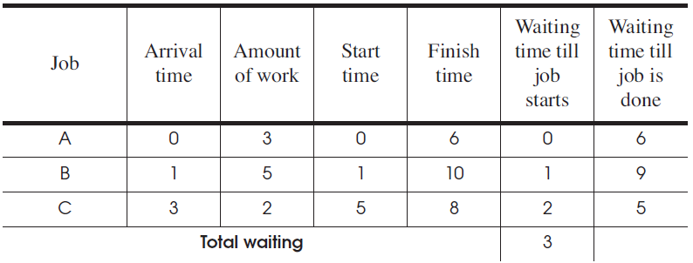
Round-Robin

Slide 40
Priority Scheduling Policy
Priority Scheduling Policy
  Assign each job a priority number
  Select the job with the highest priority number
  Must have some rule to break ties
Modern CPU schedulers have
  Priorities
    Run job with the highest priority
  Round Robin
    Alternate among jobs of same priority Preempt job if it holds CPU too long

Slide 41
CPU Scheduling Policy
Assign priorities to jobs
  Give high priorities to I/O-bound jobs
  Give low priorities to CPU-bound jobs
  Handles I/O-bound and CPU-bound jobs nicely

Slide 42
CPU Scheduling Policy
Challenge: distinguish I/O-bound and CPU-bound
  Look at past behavior to predict the future
    Linux: Priority of job is function of amount of CPU it has used
  Counter intuitive:
    More CPU a job uses/needs, the lower its priority
    The less CPU it uses, the higher its priority
      Avoids starvation problems – Not running gives you a high priority

Slide 43
Multilevel Feedback Queue
A process can move between the various queues; aging can be implemented this way.
Multilevel-feedback-queue scheduler defined by the following parameters:
  number of queues
  scheduling algorithms for each queue
  method used to determine when to upgrade a process
  method used to determine when to demote a process
  method used to determine which queue a process will enter when that process needs service

Slide 44
Example of Multilevel Feedback Queue
Three queues:
  Q₀ – time quantum 8 milliseconds
  Q₁ – time quantum 16 milliseconds
  Q₂ – FCFS
Scheduling
  A new job enters queue Q₀ which is served FCFS. When it gains CPU, job receives 8 milliseconds. If it does not finish in 8 milliseconds, job is moved to queue Q₁.
  At Q₁ job is again served FCFS and receives 16 additional milliseconds. If it still does not complete, it is preempted and moved to queue Q₂.

Slide 45

Multilevel Feedback Queues

Slide 46
Real-Time Scheduling
Processes are time sensitive
Missed deadline = incorrect behavior
Soft real time:
  Display video frame every 30th of sec
Hard real time:
  “apply-breaks” process in your car
Scheduling more than one thing:
  memory, network bandwidth, CPU all at once

Slide 47
Disk Scheduling Goals
Minimize time spent waiting on disk mechanisms
  Moving the disk arm
  Waiting for sector to rotate under disk heads
Fairness
  Should not make requests wait too long
  – Tensions here too
Power?
0, 90, 5, 100

Slide 48
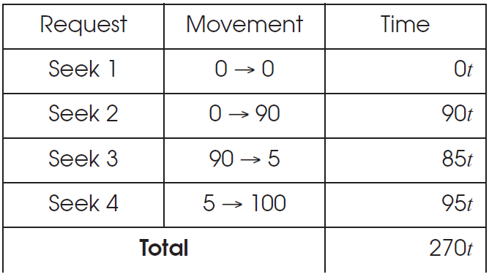
Disk Scheduling： FCFS （ 0, 90, 5, 100 ）

Slide 49
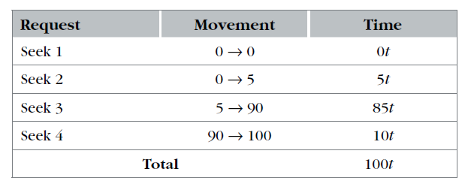
Disk Scheduling：
sort the requests by track number，0,5,9,100

Slide 50
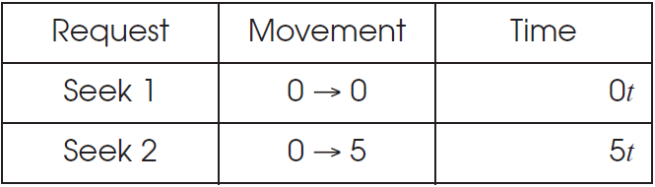
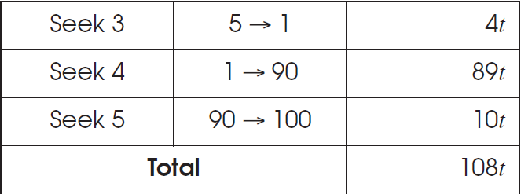
Shortest-Seek-First
Track (1) come

Slide 51
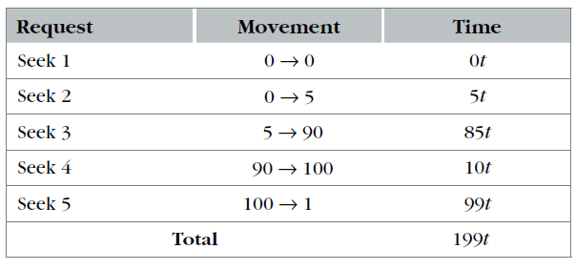
Elevator Algorithm
track1，come

Slide 52
Disk Scheduling
The operating system is responsible for using hardware efficiently — for the disk drives, this means having a fast access time and disk bandwidth.
Access time has two major components
  Seek time is the time for the disk are to move the heads to the cylinder containing the desired sector.
  Rotational latency is the additional time waiting for the disk to rotate the desired sector to the disk head.
Minimize seek time
Seek time ≈ seek distance
Disk bandwidth is the total number of bytes transferred, divided by the total time between the first request for service and the completion of the last transfer.

Slide 53
Disk Structure
Disk drives are addressed as large 1-dimensional arrays of logical blocks, where the logical block is the smallest unit of transfer.
The 1-dimensional array of logical blocks is mapped into the sectors of the disk sequentially.
  Sector 0 is the first sector of the first track on the outermost cylinder.
  Mapping proceeds in order through that track, then the rest of the tracks in that cylinder, and then through the rest of the cylinders from outermost to innermost.

Slide 54

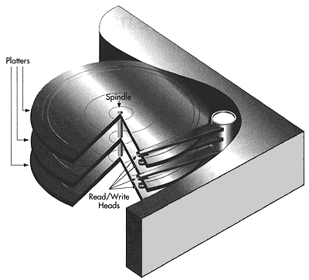
hard disk structure

Slide 55
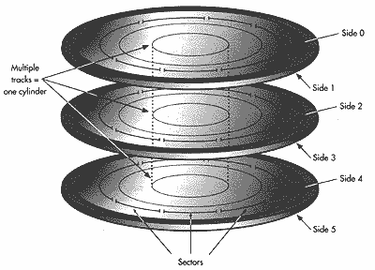
cylinder

Slide 56
磁臂
sector
cylinder
head

Slide 57
Disk Scheduling (Cont.)
Several algorithms exist to schedule the servicing of disk I/O requests.
We illustrate them with a request queue (0-199).
98, 183, 37, 122, 14, 124, 65, 67
Head pointer 53

Slide 58
Disk Scheduling (Cont.)
Several algorithms exist to schedule the servicing of disk I/O requests.
We illustrate them with a request queue (0-199).
98, 183, 37, 122, 14, 124, 65, 67
Head pointer 53

Slide 59

FCFS—first come first serve
Illustration shows total head movement of 640 cylinders.

Slide 60
SSTF---shortest seek time first
Selects the request with the minimum seek time from the current head position.
SSTF scheduling is a form of SJF scheduling; may cause starvation of some requests.
Illustration shows total head movement of 236 cylinders.

Slide 61

SSTF (Cont.)

Slide 62
SCAN
The disk arm starts at one end of the disk, and moves toward the other end, servicing requests until it gets to the other end of the disk, where the head movement is reversed and servicing continues.
Sometimes called the elevator algorithm.
Illustration shows total head movement of 208 cylinders.
advantage:
  the waiting time is predictable
  good for busy access requests

Slide 63
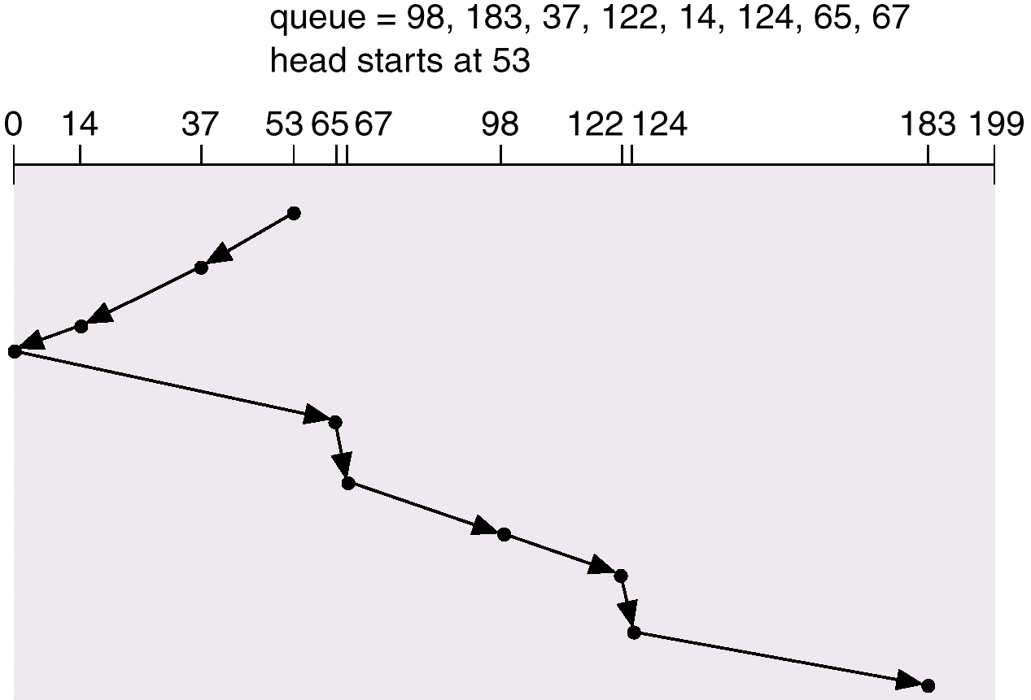
SCAN (Cont.)

Slide 64
C-SCAN
Provides a more uniform wait time than SCAN.
The head moves from one end of the disk to the other. servicing requests as it goes. When it reaches the other end, however, it immediately returns to the beginning of the disk, without servicing any requests on the return trip.
Treats the cylinders as a circular list that wraps around from the last cylinder to the first one.

Slide 65

C-SCAN (Cont.)

Slide 66
C-LOOK
Version of C-SCAN
Arm only goes as far as the last request in each direction, then reverses direction immediately, without first going all the way to the end of the disk.

Slide 67

C-LOOK (Cont.)

Slide 68
Selecting a Disk-Scheduling Algorithm
SSTF is common and has a natural appeal
SCAN and C-SCAN perform better for systems that place a heavy load on the disk.
Performance depends on the number and types of requests.
Requests for disk service can be influenced by the file-allocation、directory and inode allocation method.
The disk-scheduling algorithm should be written as a separate module of the operating system, allowing it to be replaced with a different algorithm if necessary.
Either SSTF or LOOK is a reasonable choice for the default algorithm.
other consideration:
  rotational latency
  update order for file system consistency

